Slide 1






INVISIBLE LIGHT SWITCH USING
NODEMCU
Presented by: Shivansh Mishra

Slide 2

Overview
Introduction
Core Technology
Flow of Working
Technology Demo
Advantages
Security measures
Conclusion

Slide 3


INTRODUCTION
The Invisible Light Switch utilizing NodeMCU embodies modern home automation, eliminating physical switches for a sleek, minimalist aesthetic. Powered by the ESP8266 WiFi module, this IoT-enabled switch connects to your home network, offering remote control via smartphone

Slide 4

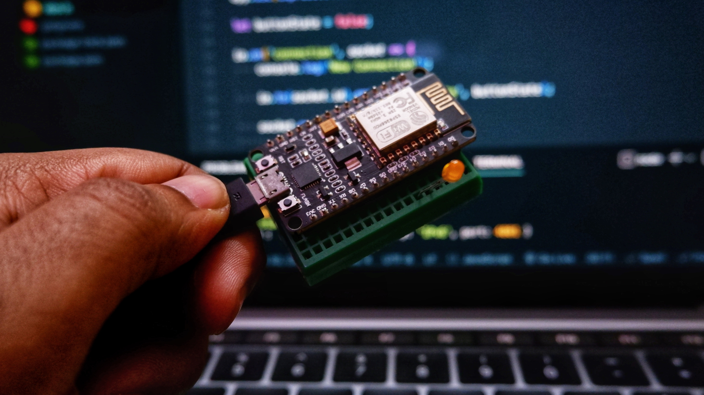
Core Technology
Internet of Things (IoT)
NodeMCU ESP8266 Microcontroller Wireless Connectivity
Embedded Systems Programming
Wi-Fi Technology
Message Queuing Telemetry Transport (MQTT)
IoT-enabled Efficiency
Sensors and Actuators

Slide 5
Flow of Control
The system initializes when a user enters the room
The invisible light switch uses
lDR sensors to detect the presence of a person
Upon detecting a person, the system processes the signals
it triggers the light control mechanism to turn the lights on, off.
Relay Automaically gets triggered at given time.
Ex. On/OFF at -6 AM & 6PM

Slide 6
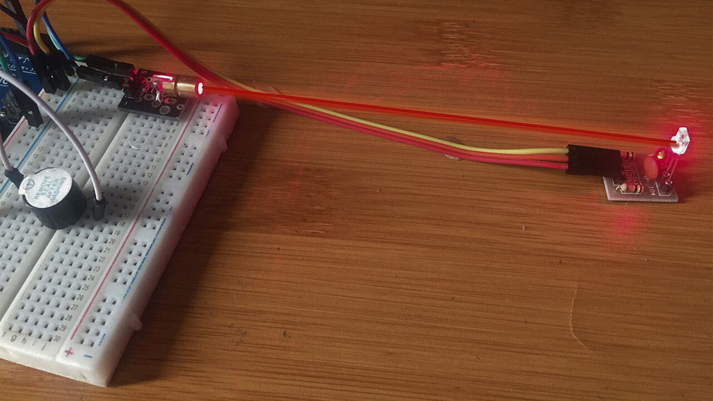
Working
The NodeMCU-based system integrates a laser sensor and LDR sensor to detect motion and temperature. The NodeMCU ESP8266 processes sensor inputs, triggering the control of a light bulb. Additionally, scheduled automation turns the bulb on/off at specific times, while real-time temperature monitoring enhances environmental awareness, making this home automation project a versatile and user-centric solution.

Slide 7
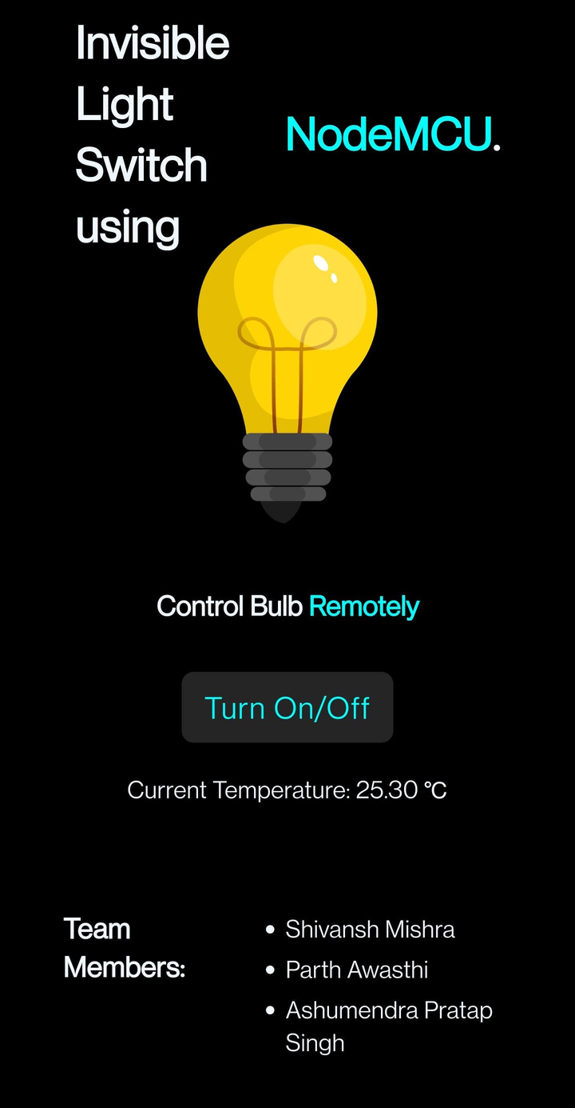
Web Page Preview
The system enables remote light control via a web interface accessible from mobile devices or laptops, incorporating a user-friendly on/off switch.
Users can also see the current Temperature on it.

Slide 8
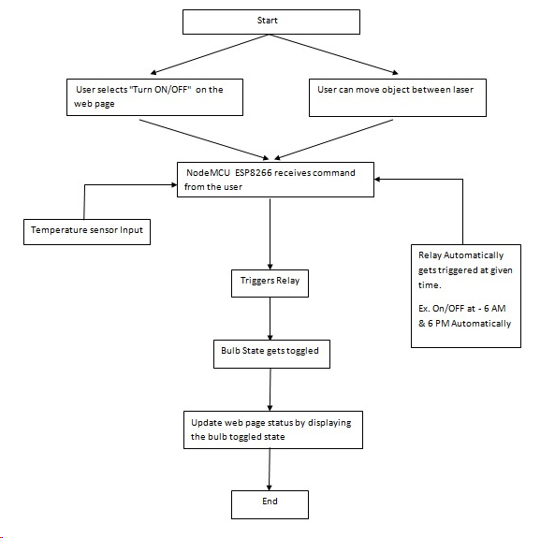
Activity Diagram

Slide 9
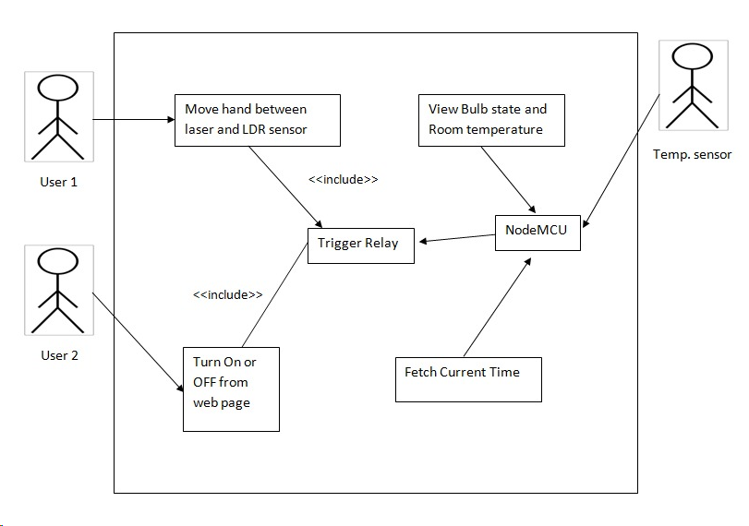
Use Case Diagram

Slide 10
Key Features
Wireless Connectivity
IoT-Enabled
Minimalist Design
Smartphone Control
Energy Efficiency
Security Features

Slide 11
Team Members
Shivansh Mishra
Ashumendra Pratap Singh
Parth Awasthi

